Slide 1

SPIDER EE TASK 2 S ARAVINDH KRISHNA/107122100/EEE
Build a line-following robot. Given two IR sensors, two motors with wheels attached, a motor driver, all necessary parts and an arena where the lane is black and the background is white. Given only one ADC128S102. You must make the bot follow the line by using these components and basic digital circuits. Use of any kind of microcontroller is prohibited

Slide 2
COMPONENTS REQUORED
ADC128S102
SHIFT REGISTERS
12 BIT COMPARATOR
RESISTORS
CAPACITORS
MULTIPLEXERS AND DE-MULTIPLEXERS
LOGIC TOGGLES
ADC128S102

Slide 3

FLOW OF THE TASK
OUTPUT OF TWO IR SENSORS ARE FED INTO ADC128S102 TWO INPUT PINS
SCLK,CS AND Din PINS ARE GIVEN SEPARATE DIGITAL INPUTS WHERE CS SHOULD BE LOW IN ORDER FOR THE ADC TO INPUT VALUES.
THE INPUT SIGNALS FOR Din ARE SENT AS SERIAL 8 BIT DATA AS AN ADDRESS FOR EACH INPUT PIN (FOR EG:00010000 means pin IN0)
SCLK MUST CONTAIN 16 EDGES FOR EACH SERIAL DATA FRAME.A SERIAL FRAME IS INITIATED ON THE FALLING EDGE OF CS AND ENDS ON THE RISING EDGE OF CS.
THE Dout FROM THE ADC IS SENT TO A SERIAL IN PARALLEL OUT SHIFT REGISTER WHICH CONVERTS THE SERIAL DATA TO PARALLEL DATA
THE PARALLEL DATA IS THEN SENT TO A 12 BIT GATE LEVEL COMPARATOR WHICH THEN OUTPUTS A SINGLE VALUE
DE-MULTIPLEXER IS USED TO SELECT THE DC MOTOR TO WHICH THE OUTPUT SHOULD BE DIRECTED

Slide 4
EXPLANATION FOR EACH COMPONENTS-
SHIFT REGISTERS
TYPES INCLUDE - SERIAL IN − SERIAL OUT SHIFT REGISTER. SERIAL IN − PARALLEL OUT SHIFT REGISTER. PARALLEL IN − SERIAL OUT SHIFT REGISTER. PARALLEL IN − PARALLEL OUT SHIFT REGISTER.
SHIFT REGISTER BASICALLY CONVERTS SERIAL DATA TO PARALLEL FORMS OR VICE -VERSA.
AS THE 12 BIT GATE LEVEL COMPARATOR REQUIRES ONLY BIT BY BIT PARALLEL INPUT ,IT IS NECESSARY TO CONVERT THE SERIAL OUTPUT FROM THE Dout PIN OF THE ADC.
12 BIT COMPARATOR
A COMPARATOR GENERALLY COMPARES THE INPUT VALUES A AND B AND RETURNS RESULTS A>B,A=B AND A<B. THE INPUTS A AND B ARE FED AS BITS INT0 THE COMPARATOR.HERE THE VOLTAGE VALUE OF WHITE(1.8-3.3) > BLACK(0-1.8) AND THE COMPARATOR HELPS THE MOTOR TO CHANGE DIRECTION ACCORDING TO THE COMPARED OUTPUT RESULT (IF VOLTAGE < 1.8 IT IS A BLACK PATH TURN IN A WHITE BACKGROUND).3.3 IS ASSIGNED THE VALUE OF 111111111111 AND 1.8 THE VALUE OF 100010111001.

Slide 5
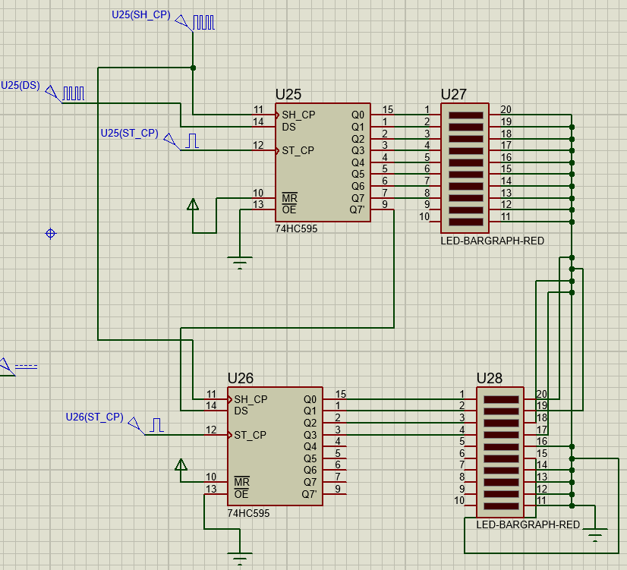
SHIFT REGISTER 12 BIT (COMBINATION OF TWO 8 BIT SENSORS). HERE LED BARGRAPHS ARE USED TO INDICATE THE OUTPUT BITS.

Slide 6
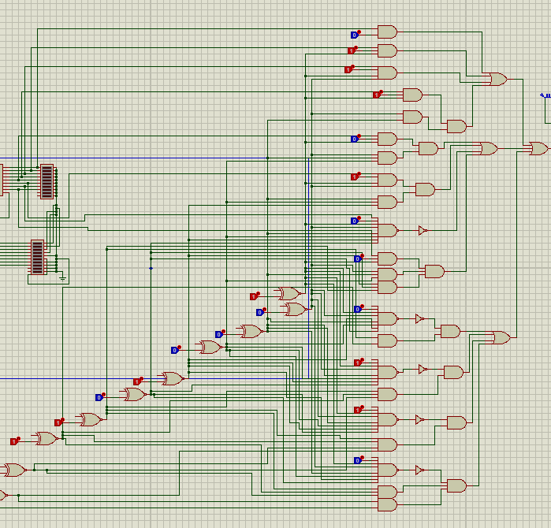
12 BIT COMPARATOR

Slide 7
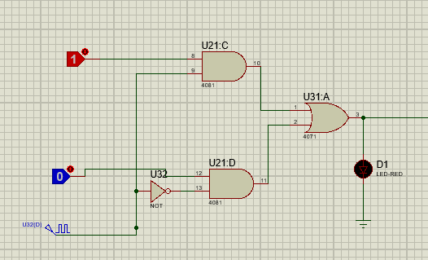
2 INPUT MULTIPLEXER SELECTS WHICH INPUT PIN (IN0 OR IN7) TO BE SELECTED BY THE ADC ACCORDING TO THE SPECIFIC TIMING GIVEN BY THE CLOCK SIGNAL. WHEN CLK IS HIGH INPUT 1 IS SELECTED AND WHEN CLOCK IS LOW INPUT 0 IS SELECTED.

Slide 8
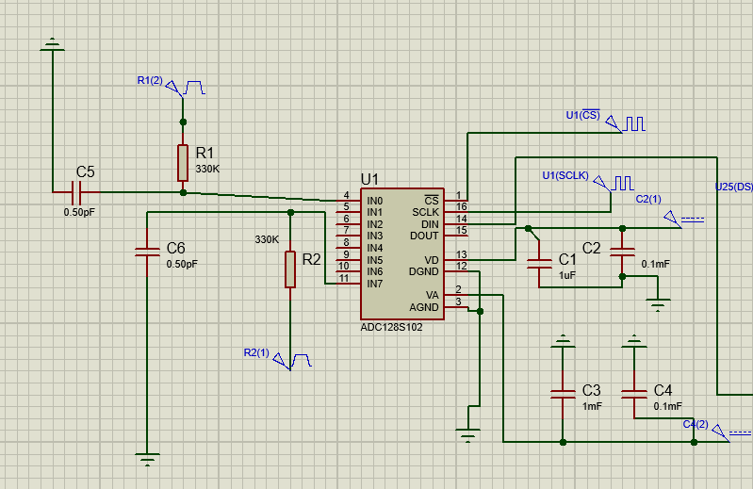
ADC128S102 (USING INPUT PINS IN0 AND IN7)

Slide 9
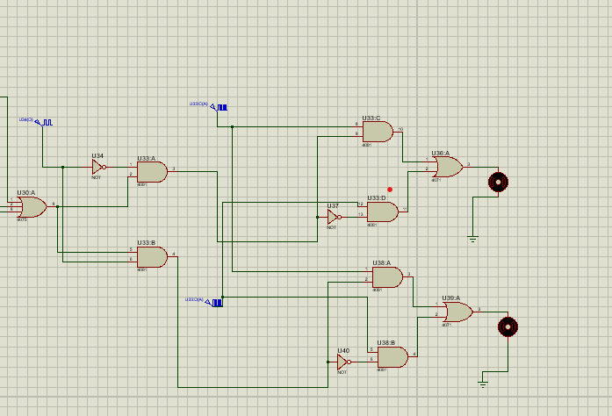
SELECTOR:- (DE-MULTIPLEXER FOR 2 MOTORS) AND 2 SEPARATE MULTIPLEXERS FOR SELECTING THE REQUIRED PWM SIGNAL FOR SPEED OF MOTORS.HERE ONE PWM SOURCE HAS HIGH PULSE WIDTH AND THE OTHER HAS A LOW PULSE WIDTH

Slide 10
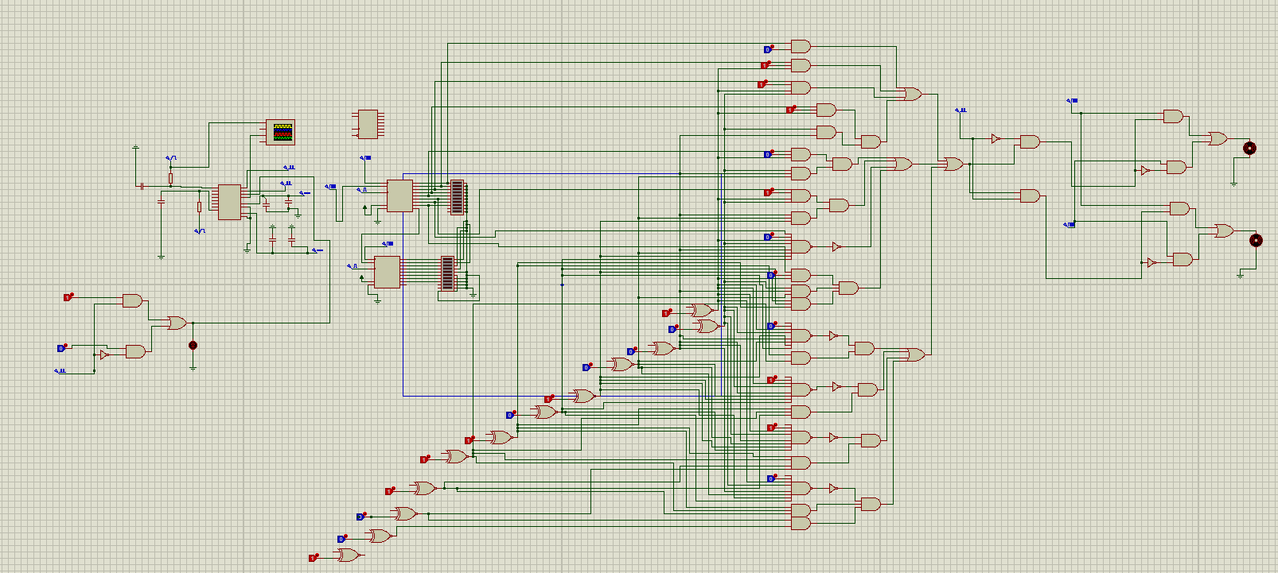
OVERALL DESIGN

